Slide 1








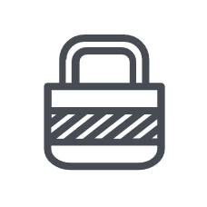
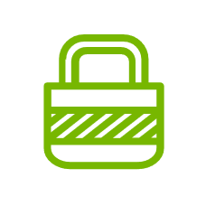










raising security awareness on password security
Use Passphrases
easy-to-remember sentences or phrases.
Length
Passphrases should be at least 14 characters long. Longer is better, making them more difficult to crack through brute-force attacks
Randomness
Choose random words or phrases, not personal information like names, birthdays, or common words
Unpredictability
Avoid using sentences or patterns that can be easily guessed
Account Specific
Use a different passphrase for every online account
Avoid Simple Passwords
Don't use easily guessable passwords like "password123" or personal information
Don't Reuse Passwords
Avoid using the same password across multiple accounts
Consider Password Managers
Password managers can help you create, store, and manage strong, unique passwords, and also provide security checks, Bitwarden.com
Two-Factor Authentication (2FA)
If available, enable 2FA for additional security
Keep Passwords Secret
Never share your passwords with anyone

